Slide 1
IC Logic Families

Slide 2
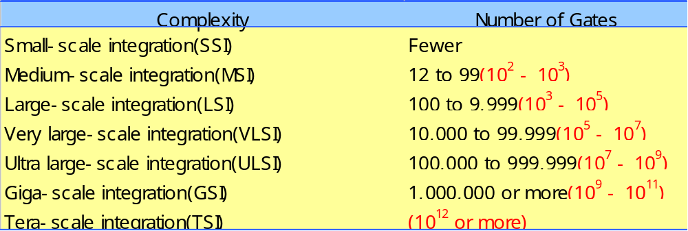
Introduction
  Digital IC technology has advanced rapidly
    Moore’s Law
      The number of components that can be packed on a computer chip doubles every 18 months while price stays the same.

Slide 3
  Most of the reasons that modern digital systems use integrated circuits
    Integrated circuits pack a lot more circuitry in a small package
      the overall size of any digital system is reduced
        the cost is dramatically reduced because of the economies of mass-producing large volumes of similar devices
    Integrated circuits have made digital systems more reliable by reducing the number of external interconnections
      Discrete components(transistor, diode, resistor, etc.) are protected from poor soldering, breaks or shorts in connecting paths on a circuit board

Slide 4
    Integrated circuits have drastically reduced the amount of electrical power needed to perform a given function
      Integrated circuitry typically requires less power than their discrete counterparts
        the saving in power supply costs
        a system does not require as much cooling
  There are some things that Integrated circuits cannot do
    Integrated circuits can not handle very large currents or voltages (because the heat generated in such small spaces would cause temperatures to rise beyond acceptable limits)
    Integrated circuits can not easily implement certain electrical devices such as inductors, transformers, and large capacitors

Slide 5
  For these reason
    Integrated circuits are principally used to perform low-power circuit operations that are commonly called information processing
    The operations that require high power levels or devices that can not be integrated are still handled by discrete components
  Various Logic Families
    Bipolar transistors : TTL and ECL
    Unipolar MOSFET transistors : NMOS, PMOS, and CMOS

Slide 6
Logic Families Vocabulary
TTL (Transistor Transistor Logic) Integrated-circuit technology that uses the bipolar transistor as the principal circuit element.
CMOS (Complimentary Metal Oxide Semiconductor) Integrated-circuit technology that uses the field-effect transistor as the principal circuit element.
ECL (Emitter Coupled Logic) Integrated-circuit technology that uses the bipolar transistors configured as a differential amplifier. This eliminates saturation and improves speed but uses more power than other families.

Slide 7
Digital IC Terminology
Voltage Parameters:
  V_{IH}(min): high-level input voltage, the minimum voltage level required for a logic 1 at an input.
  V_{IL}(max): low-level input voltage
  V_{OH}(min): high-level output voltage
  V_{OL}(max): low-level output voltage

Slide 8
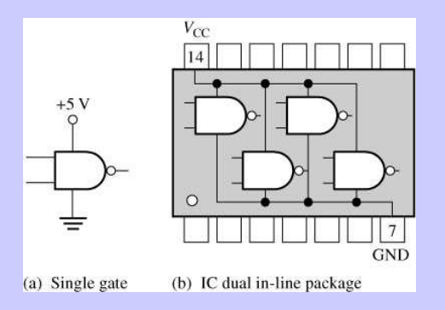

Slide 9
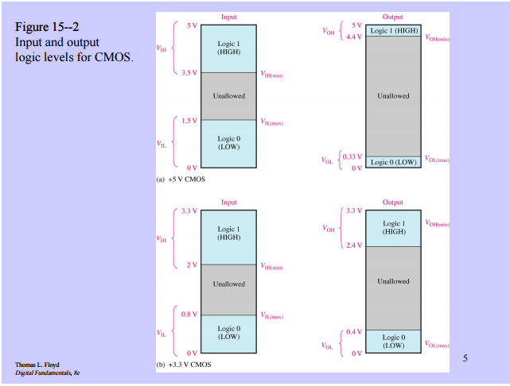

Slide 10
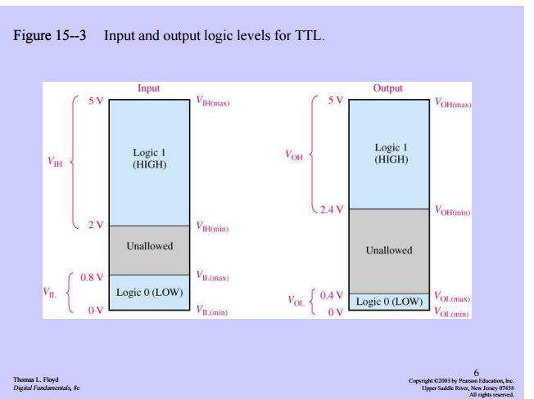

Slide 11
Current Parameters
I_{IH}(min): high-level input current, the current that flows into an input when a specified high-level voltage is applied to that input.
I_{IL}(max): low-level input current
I_{OH}(min): high-level output current
I_{OL}(max): low-level output current

Slide 12
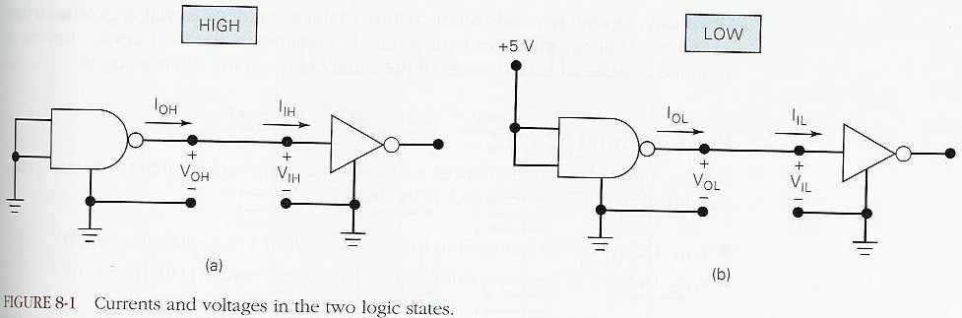
Figure 8-1

Slide 13
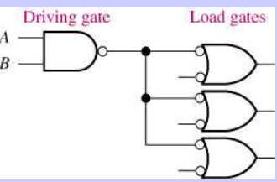
Fan-Out
The maximum number of standard logic inputs that an output can drive reliably.
Also known as the loading factor.
Related to the current parameters (both in high and low states.)

Slide 14
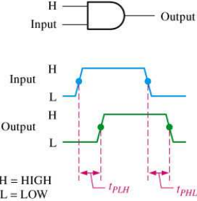
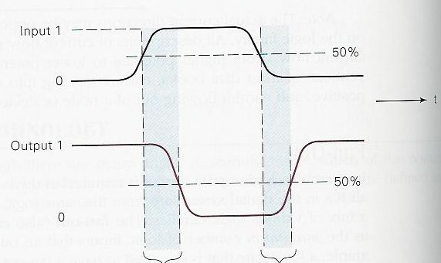
Propagation Delays
t_{pLH}: delay time in going from logical 0 to logical 1 state (LOW to HIGH)
t_{pHL}: delay time in going from logical 1 to logical 0 state (HIGH to LOW)
Measured at 50%
points.

Slide 15
Power Requirements
Every IC needs a certain amount of electrical power to operate.
V_{cc} (TTL)
V_{DD}(MOS)
Power dissipation determined by I_{cc} and V_{cc}.
Average I_{cc}(avg)= (I_{CCH} + I_{CCL})/2
P_{D}(avg) = I_{cc}(avg) x V_{cc}

Slide 16
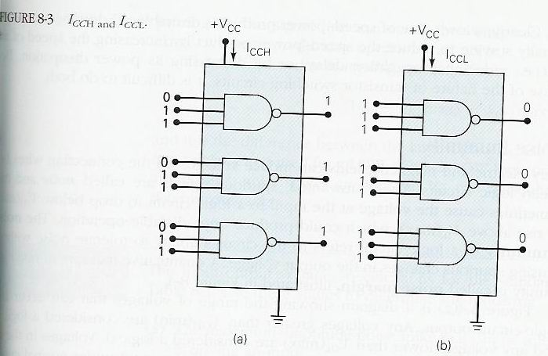
Figure 8-3

Slide 17
Speed-Power Product
Desirable properties:
  Short propagation delays (high speed)
  Low power dissipation
Speed-power product measures the combined effect.

Slide 18
Noise Immunity
What happens if noise causes the input voltage to drop below V_{IH}(min) or rise above V_{IL}(max)?
The noise immunity of a logic circuit refers to the circuit’s ability to tolerate noise without causing spurious changes in the output voltage.
Noise margin: Figure 8-4.
V_{NH}=V_{OH}(min)-V_{IH}(min)
V_{NL}=V_{IL}(max)-V_{OL}(max)
Example 8-1.

Slide 19
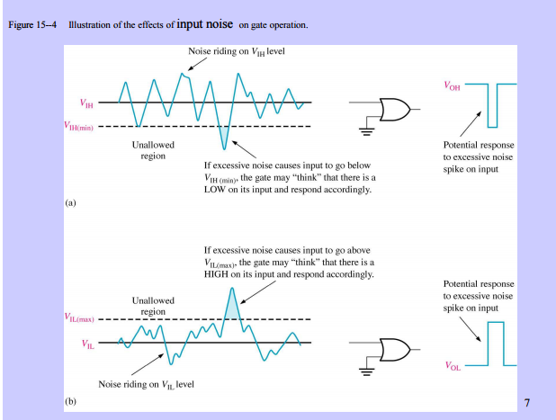

Slide 20
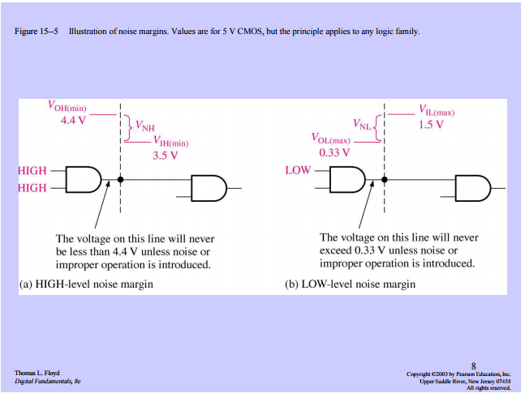

Slide 21
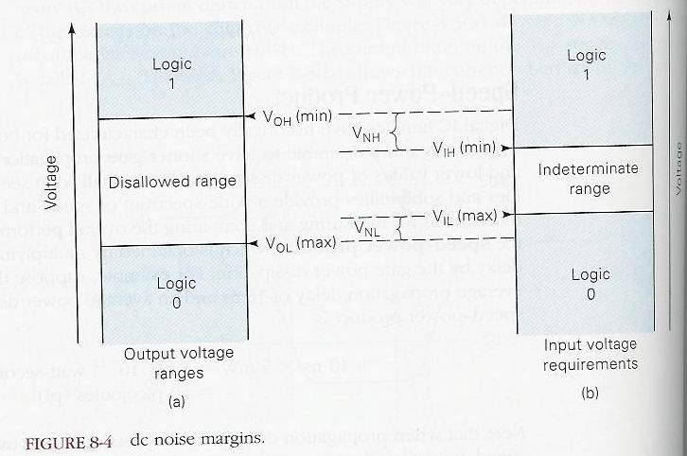
Figure 8-4: Noise Margin

Slide 22
Invalid Voltage Levels
For proper operation the input voltage levels to a logic must be kept outside the indeterminate range.
Lower than V_{IL}(max) and higher than V_{IH}(min).

Slide 23
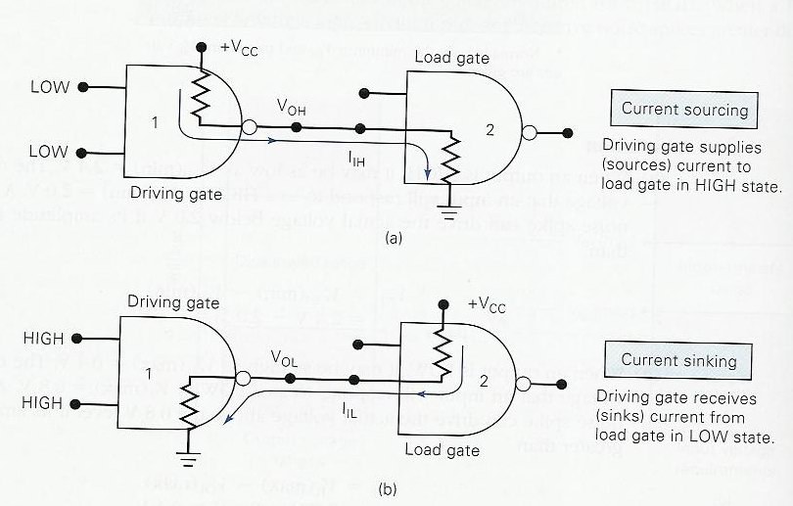
Current-Sourcing and Sinking

Slide 24
IC Packages
DIP
J-Lead
Gull-wing
Table 8-2 for a complete list.

Slide 25
The TTL Logic Family
Transistor-transistor logic
Figure 8-7: NAND gate.
Circuit operation: LOW state, current-sinking
Circuit operation: HIGH state, current-sourcing.

Slide 26
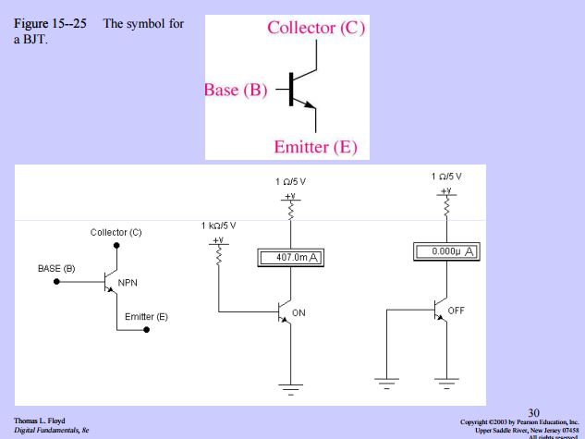

Slide 27
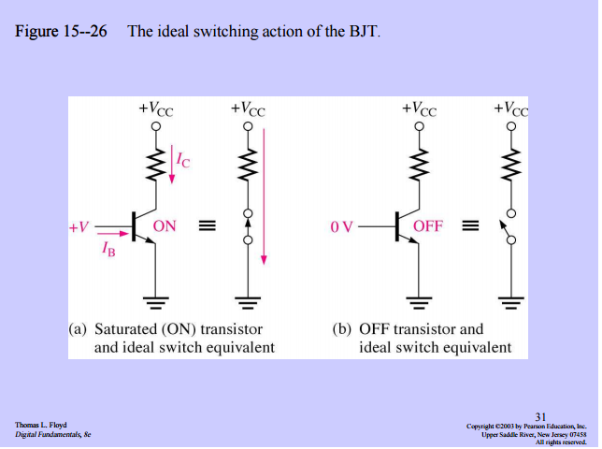

Slide 28
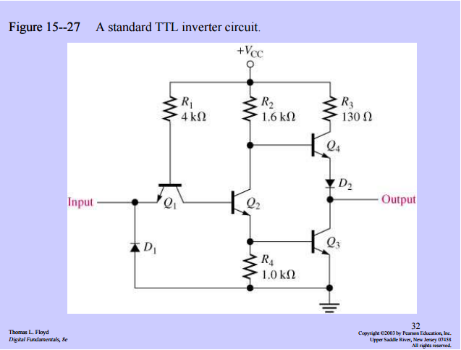

Slide 29
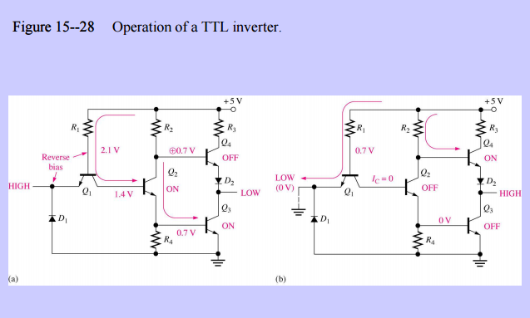

Slide 30
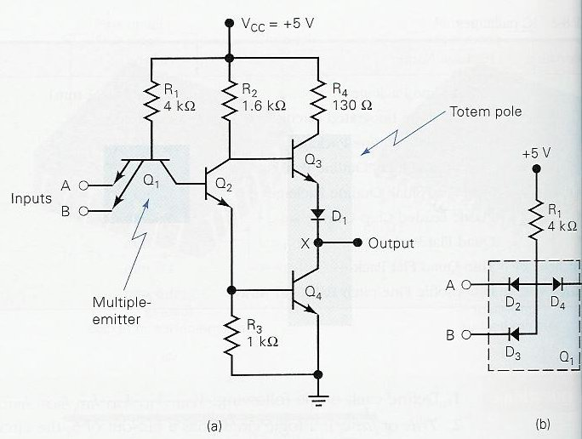
TTL NAND Gate

Slide 31
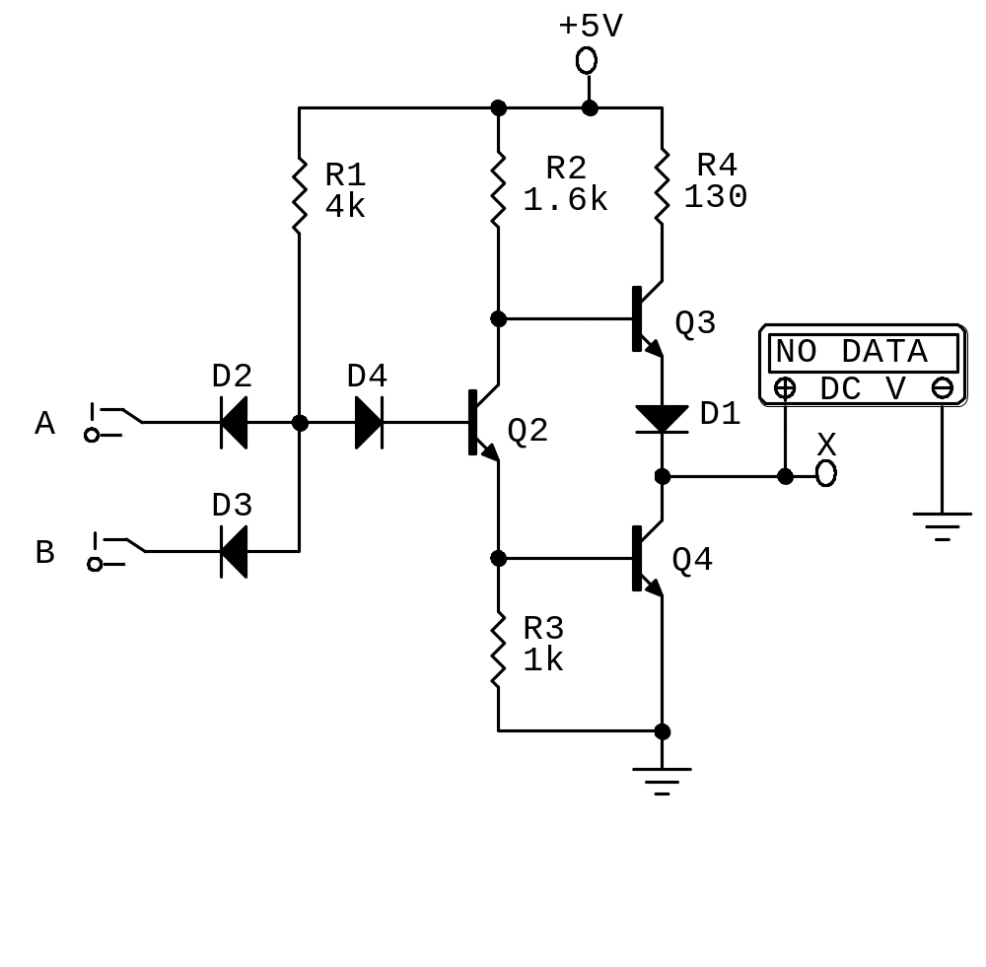
Figure 8-8: TTL NAND Gate

Slide 32
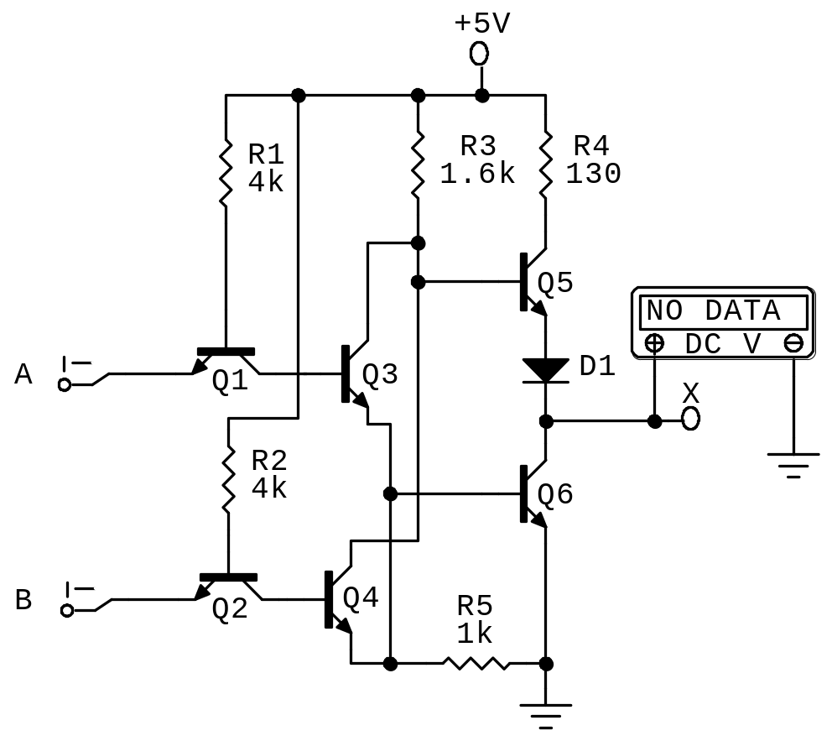
TTL NOR Gate Circuit

Slide 33
Standard TTL Series Characteristics
TI introduced first line of standard TTL: 54/74 series (1964)
Manufacturers’ data sheets (Figure 8-11)
  Supply voltage and temperature range
  Voltage levels
  Maximum voltage ratings
  Power dissipation
  Propagation delays
  Fan-out
Example 8-2

Slide 34
Improved TTL Series
74 Series
Schottky TTL, 74S Series: higher speed
Low-Power Schottky TTL, 74LS series
Advanced Schottky TTL, 74AS Series
Advanced Low-Power Schottky TTL, 74ALS Series
74F-Fast TTL

Slide 35
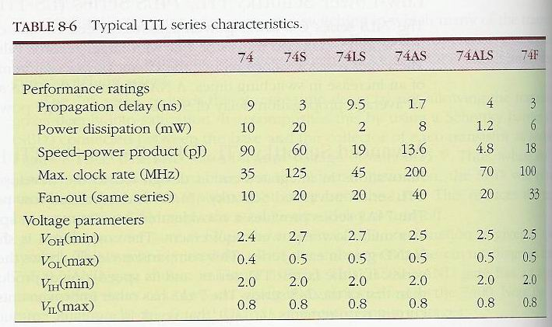
Comparison of TTL Series

Slide 36
Examples
Example 8-3: Noise margin of 74 and 74LS
Example 8-4: TTL series with max number of fan-out

Slide 37
TTL Loading and Fan-Out
Figure 8-13: currents when a TTL output is driving several inputs.
TTL output has a limit, I_{OL}(max), on how much current it can sink in the LOW state.
It also has a limit, I_{OH}(max), on how much current it can source in the HIGH state.

Slide 38
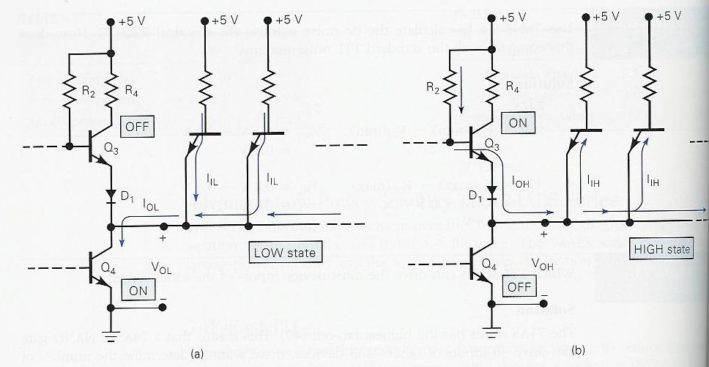
Figure 8-13

Slide 39
Determining the fan-out
Same IC family.
Find fan-out (LOW):I_{OL}(max)/I_{IL}(max)
Find fan-out (HIGH):I_{OH}(max)/I_{IH}(max)
Fan-out: smaller of the above
Example 8-6: Fan-out of 74AS20 NAND gates

Slide 40
Determining the fan-out
Different IC families
Step 1: add up the I_{IH} for all inputs connected to an output. The sum must be less than the output’s I_{OH} specification.
Step 2: add up the I_{IL} for all inputs connected to an output. The sum must be less than the output’s I_{OL} specification.
Examples 8-7 to 8-9.

Slide 41
Other TTL Characteristics
Unconnected inputs (floating): acts like a logic 1.
Unused inputs: three different ways to handle.
Tie-together inputs: common input generally represent a load that is the sum of the load current rating of each individual input. Exception: for AND and NAND gates, the LOW state input load will be the same as a single input no matter how many inputs are tied together.
Example 8-10.

Slide 42
Other TTL Characteristics (cont’d)
Current transients (Figure 8-18)
Connecting TTL outputs together
  Totem-pole outputs should no be tied together

Slide 43
MOS Digital ICs
MOS: metal-oxide-semiconductor
MOSFET: MOS field-effect transistors.
The Good:
  Simple
  Inexpensive to fabricate
  Small
  Consumes little power
The bad:
  Static-electricity damage.
  Slower than TTL

Slide 44
The MOSFET
P-MOS: P-channel MOS
N-MOS: N-channel MOS, fastest
CMOS: complementary MOS, higher speed, lower power dissipation.
Figure 8-20: how N-channel MOSFET works:
  V_{GS}=0V OFF State, R_{off}= 10¹⁰ ohms
  V_{GS}=5V ON State,R_{on}=1000 ohms

Slide 45
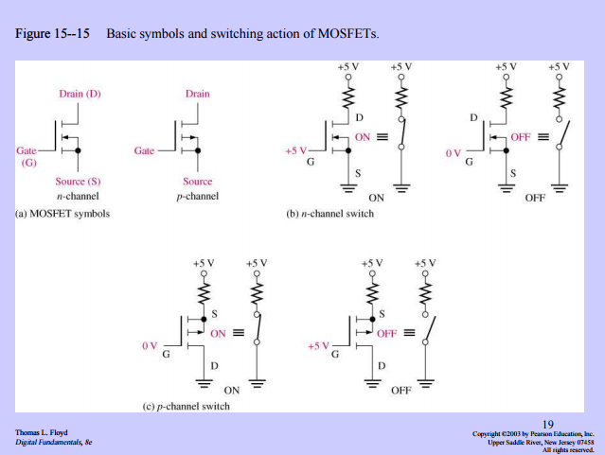

Slide 46
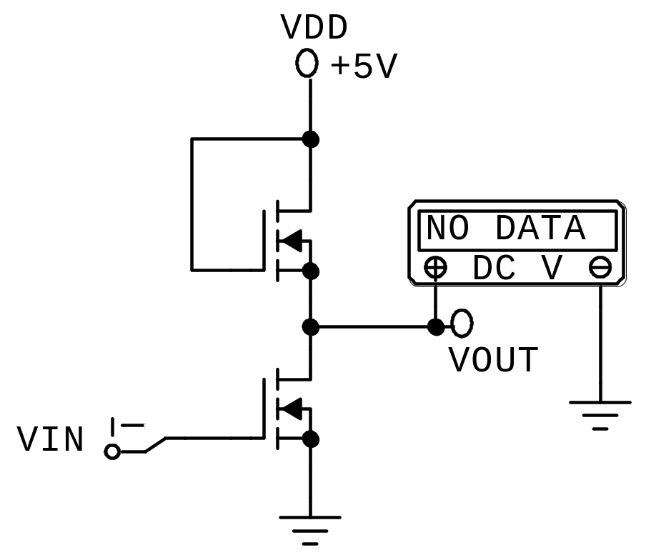
N-MOS INVERTER
V_{in} | Q₁ | Q₂ | V_{out}
0V | R_{on}= 100K | R_{off}= 10¹⁰K | 5V
5V | R_{on}= 100K | R_{on}= 1K | 0.05V
Q₁
Q₂

Slide 47
CMOS
Uses both P- and N-channel MOSFETs in the same circuit to realize several advantages over the P-MOS and N-MOS families.
CMOS INVERTER (Figure 8-22)
CMOS NAND (Figure 8-23)
CMOS NOR (Figure 8-24)

Slide 48
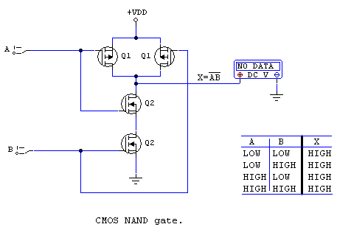
CMOS NAND Gate

Slide 49
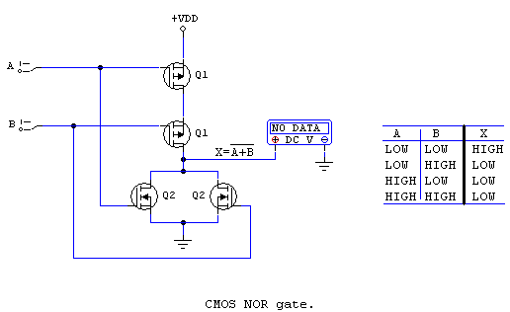
CMOS NOR Gate

Slide 50
CMOS Series Characteristics
Pin-compatible
Functionally equivalent
Electrically compatible
4000/14000 Series
74C, 74HC/HCT, 74AC/ACT, 74AHC,
BiCMOS (Bipolar + CMOS)
Table 8-10: low-voltage series characteristics
Table 8-11, comparison of ECL, CMOS and TTL Series

Slide 51
Low-Voltage Technology
5V → 3.3V
Reduces power dissipation
74LVC, 74ALVC, 74LV, 74LVT

Slide 52
Other CMOS Issues
Conventional CMOS outputs should not be connected together.
Bilateral switch (Figure 8-43,44)

Slide 53
IC Interfacing
Connecting the output(s) of one circuit to the input(s) of another circuit that has different electrical characteristics.
Occurs often in complex digital systems, where designers utilize different logic families for different parts of system.
TTL driving CMOS
CMOS driving TTL

Slide 54
TTL driving CMOS
No problem with the current requirements (See Table 8-12)
V_{OH}(min) of TTL is low compared to V_{IH}(min) of some CMOS series (Table 8-9), use pull-up resistor to raise TTL output voltage (Figure 8-46)
TTL driving high-voltage CMOS (V_{DD} of CMOS is greater than 5V)
  Use 7407 buffer
  Use voltage level-translator (such as 4504B)

Slide 55
CMOS driving TTL
HIGH state:Table 8-9 and 8-12 indicate no special consideration the HIGH state.
LOW state: depends on the series used.

